Slide 1
Java Programming
Java Programming IT-11

Slide 2
Database Programming using JDBC
Introduction to JDBC:
JDBC API is a Java API that can access any kind of tabular data, especially data stored in a Relational Database.
JDBC works with Java on a variety of platforms, such as Windows, Mac OS, and the various versions of UNIX.
JDBC stands for Java Database Connectivity, which is a standard Java API for database-independent connectivity between the Java programming language and a wide range of databases.
The JDBC library includes APIs for each of the tasks mentioned below that are commonly associated with database usage.

Slide 3
Introduction to JDBC:
Making a connection to a database.
Creating SQL statements.
Executing SQL queries in the database.
Viewing & Modifying the resulting records.

Slide 4
Components of JDBC
There are generally four main components of JDBC through which it can interact with a database. They are as mentioned below:
JDBC API: It provides various methods and interfaces for easy communication with the database. java.sql.* needs to import.
JDBC Driver manager: It loads a database-specific driver in an application to establish a connection with a database. It is used to make a database-specific call to the database to process the user request.

Slide 5
JDBC Test suite: It is used to test the operation(such as insertion, deletion, updation) being performed by JDBC Drivers.
JDBC-ODBC Bridge Drivers: It connects database drivers to the database. This bridge translates the JDBC method call to the ODBC function call. It makes use of the sun.jdbc.odbc package which includes a native library to access ODBC characteristics.

Slide 6
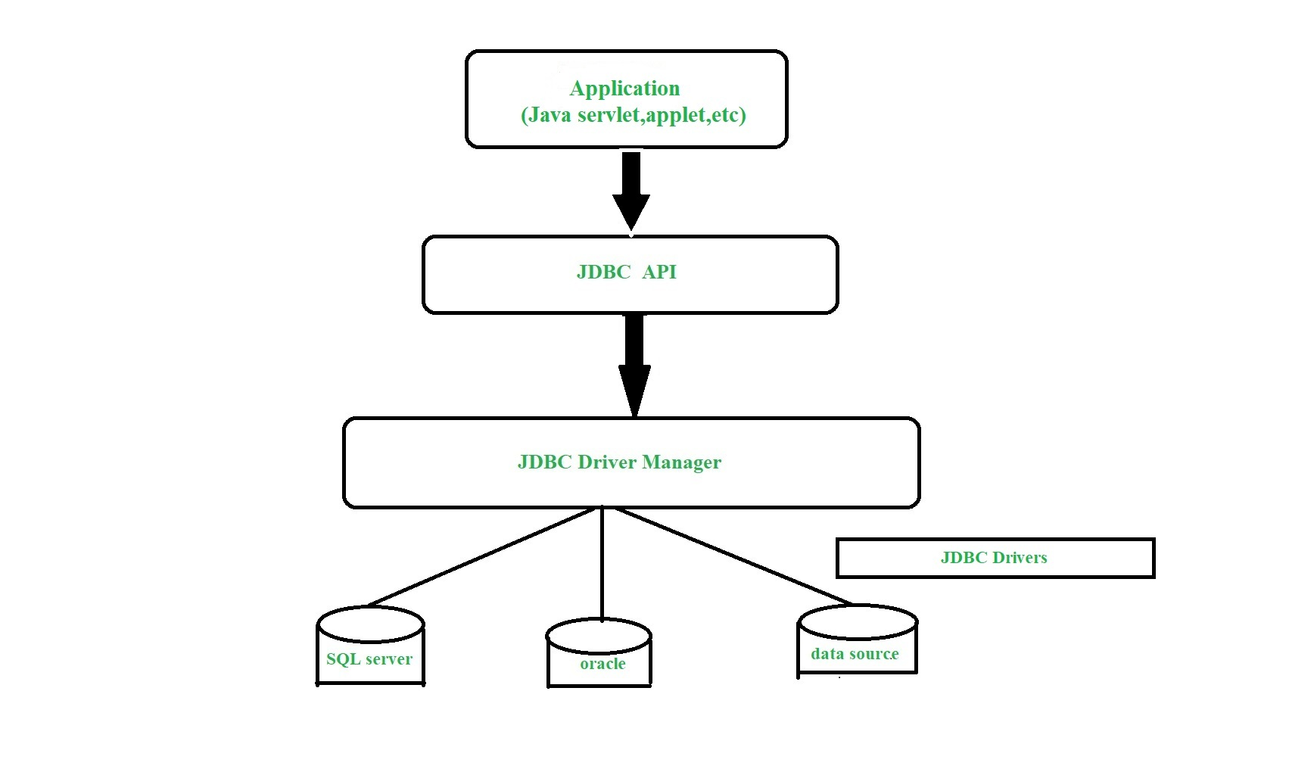
Architecture of JDBC

Slide 7
Architecture of JDBC
Application: It is a java applet or a servlet that communicates with a data source.
The JDBC API: The JDBC API allows Java programs to execute SQL statements and retrieve results. Some of the important classes and interfaces defined in JDBC API are as follows:
DriverManager: It plays an important role in the JDBC architecture. It uses some database-specific drivers to effectively connect enterprise applications to databases.
JDBC drivers: To communicate with a data source through JDBC, you need a JDBC driver that intelligently communicates with the respective data source.

Slide 8
JDBC Drivers
JDBC drivers are client-side adapters (installed on the client machine, not on the server) that convert requests from Java programs to a protocol that the DBMS can understand. There are 4 types of JDBC drivers:
Type-1 driver or JDBC-ODBC bridge driver
Type-2 driver or Native-API driver(partially java)
Type-3 driver or Network Protocol driver(fully java)
Type-4 driver or Thin driver(fully java driver)

Slide 9
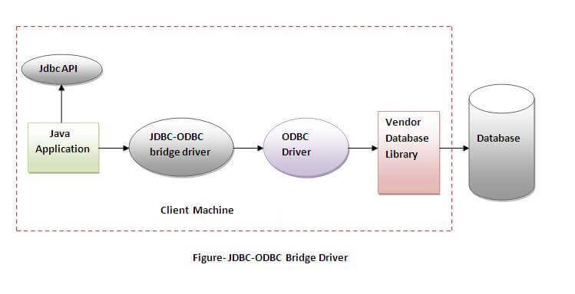
JDBC-ODBC bridge driver
The JDBC-ODBC bridge driver uses ODBC driver to connect to the database. The JDBC-ODBC bridge driver converts JDBC method calls into the ODBC function calls. This is now discouraged because of thin driver.

Slide 10
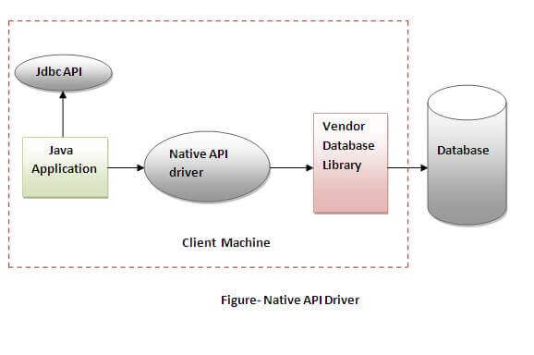
Native-API driver
The Native API driver uses the client-side libraries of the database. The driver converts JDBC method calls into native calls of the database API. It is not written entirely in java.

Slide 11
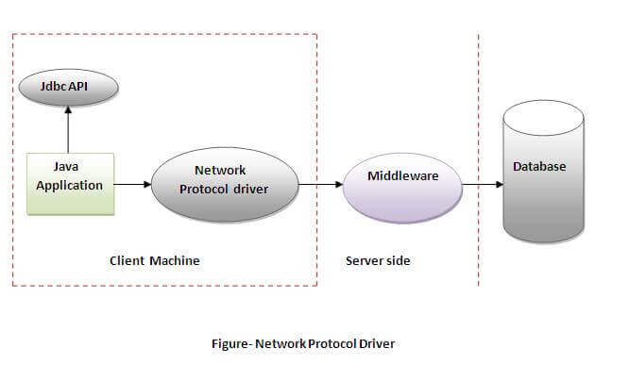
Network Protocol driver
The Network Protocol driver uses middleware (application server) that converts JDBC calls directly or indirectly into the vendor-specific database protocol. It is fully written in java.

Slide 12
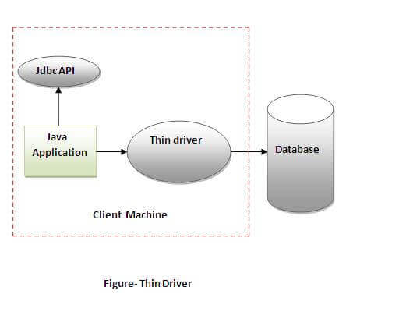
Thin driver
The thin driver converts JDBC calls directly into the vendor-specific database protocol. That is why it is known as thin driver. It is fully written in Java language.

Slide 13
Java Database Connectivity Steps
There are 5 steps to connect any java application with the database using JDBC. These steps are as follows:
Register the Driver class
Create connection
Create statement
Execute queries
Close connection

Slide 14
Register the driver class
The forName() method of Class class is used to register the driver class.
This method is used to dynamically load the driver class.
Syntax of forName() method
EX : Class.forName("oracle.jdbc.driver.OracleDriver");

Slide 15
Create the connection object
The getConnection() method of DriverManager class is used to establish connection with the database.
EX:
Connection con=DriverManager.getConnection(
"jdbc:oracle:thin:@localhost:1521:xe","system","password");

Slide 16
Create the Statement object
Statement object
The createStatement() method of Connection interface is used to create statement. The object of statement is responsible to execute queries with the database.
Statement stmt=con.createStatement();
Execute the query
The executeQuery() method of Statement interface is used to execute queries to the database. This method returns the object of ResultSet that can be used to get all the records of a table.
ResultSet rs=stmt.executeQuery("select * from emp");

Slide 17
Read data from resultset
ResultSet rs=stmt.executeQuery("select * from emp");
while(rs.next()){
System.out.println(rs.getInt(1)+" "+rs.getString(2));
}
Close the connection object:
By closing connection object statement and ResultSet will be closed automatically. The close() method of Connection interface is used to close the connection.
con.close();

